Slide 1

NAIVE BAYES
FROM
PROBABILITY
THEORY
TO MACHINE LEARNING
A Deep Dive into Dependent Events, Independent Events, and the Derivation of Bayes' Theorem
Presented by Miraj Deep Bhandari

Slide 2



THE CONCEPT OF
INDEPENDENT
EVENTS
What is Independence?
The
Die Roll
Example
Events are
Independent
if the occurrence of one
Rolling a 1 on your first try (P=1/6) has no impact on whether you roll a 2 on your second try. The outcome of the first roll is "forgotten" by the universe before the second roll occurs.
does not change the probability of the other. They exist in
separate contextual vacuums.
P(A ∩ B) = P(A) × P(B)
This simplicity allows for direct multiplication of probabilities without contextual adjustments.

Slide 3

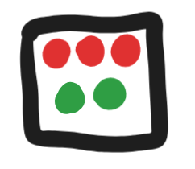


WHEN
CONTEXT
MATTERS: DEPENDENT
EVENTS
Two events are
Dependent
If The result of the first event changes the probability
of the second event.
Step 1: Initial State
Step 2: After Drawing Red
3 Red, 2 Green Marbles
2 Red, 2 Green Marbles Left
P(Red) = 3/5
P(Green) = 2/4
The denominator changes because the
Context
has been altered by the first action.

Slide 4

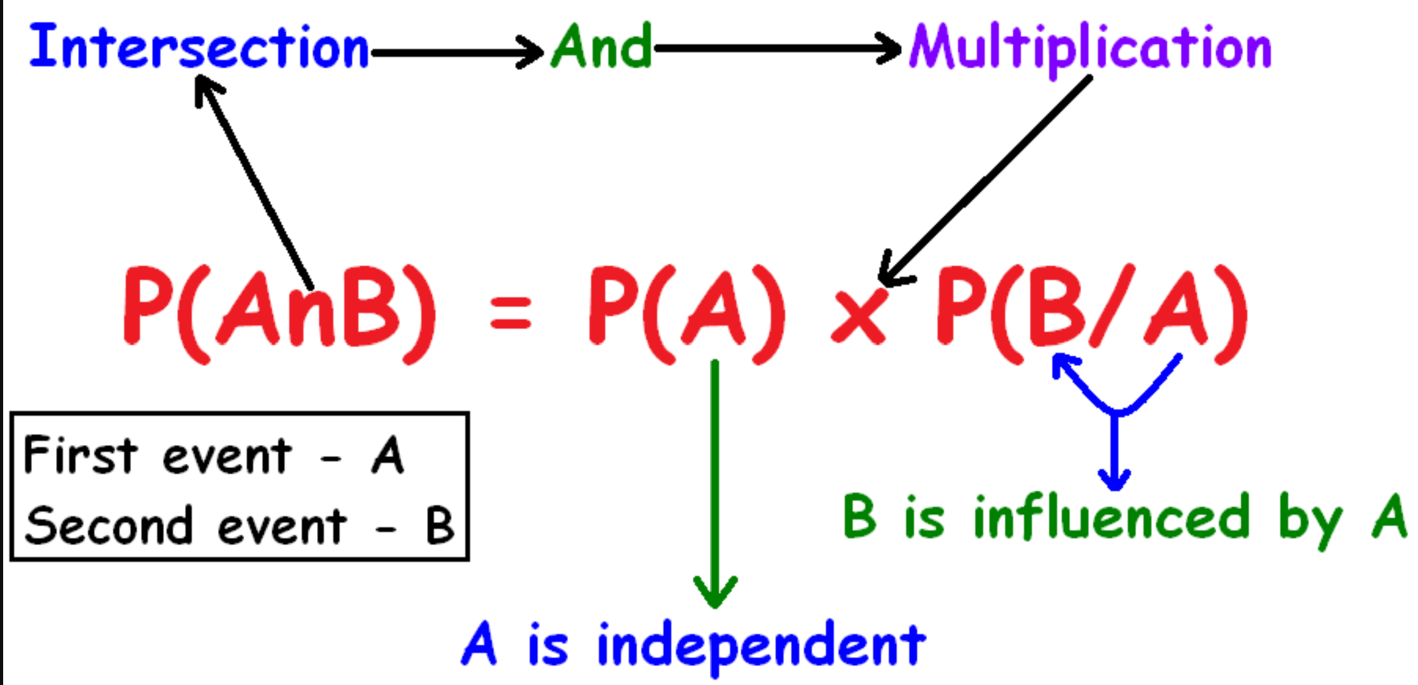
PROBABILITY
Of getting A and B
Paila A Aayera B Aauni Probability is given by:

Slide 5
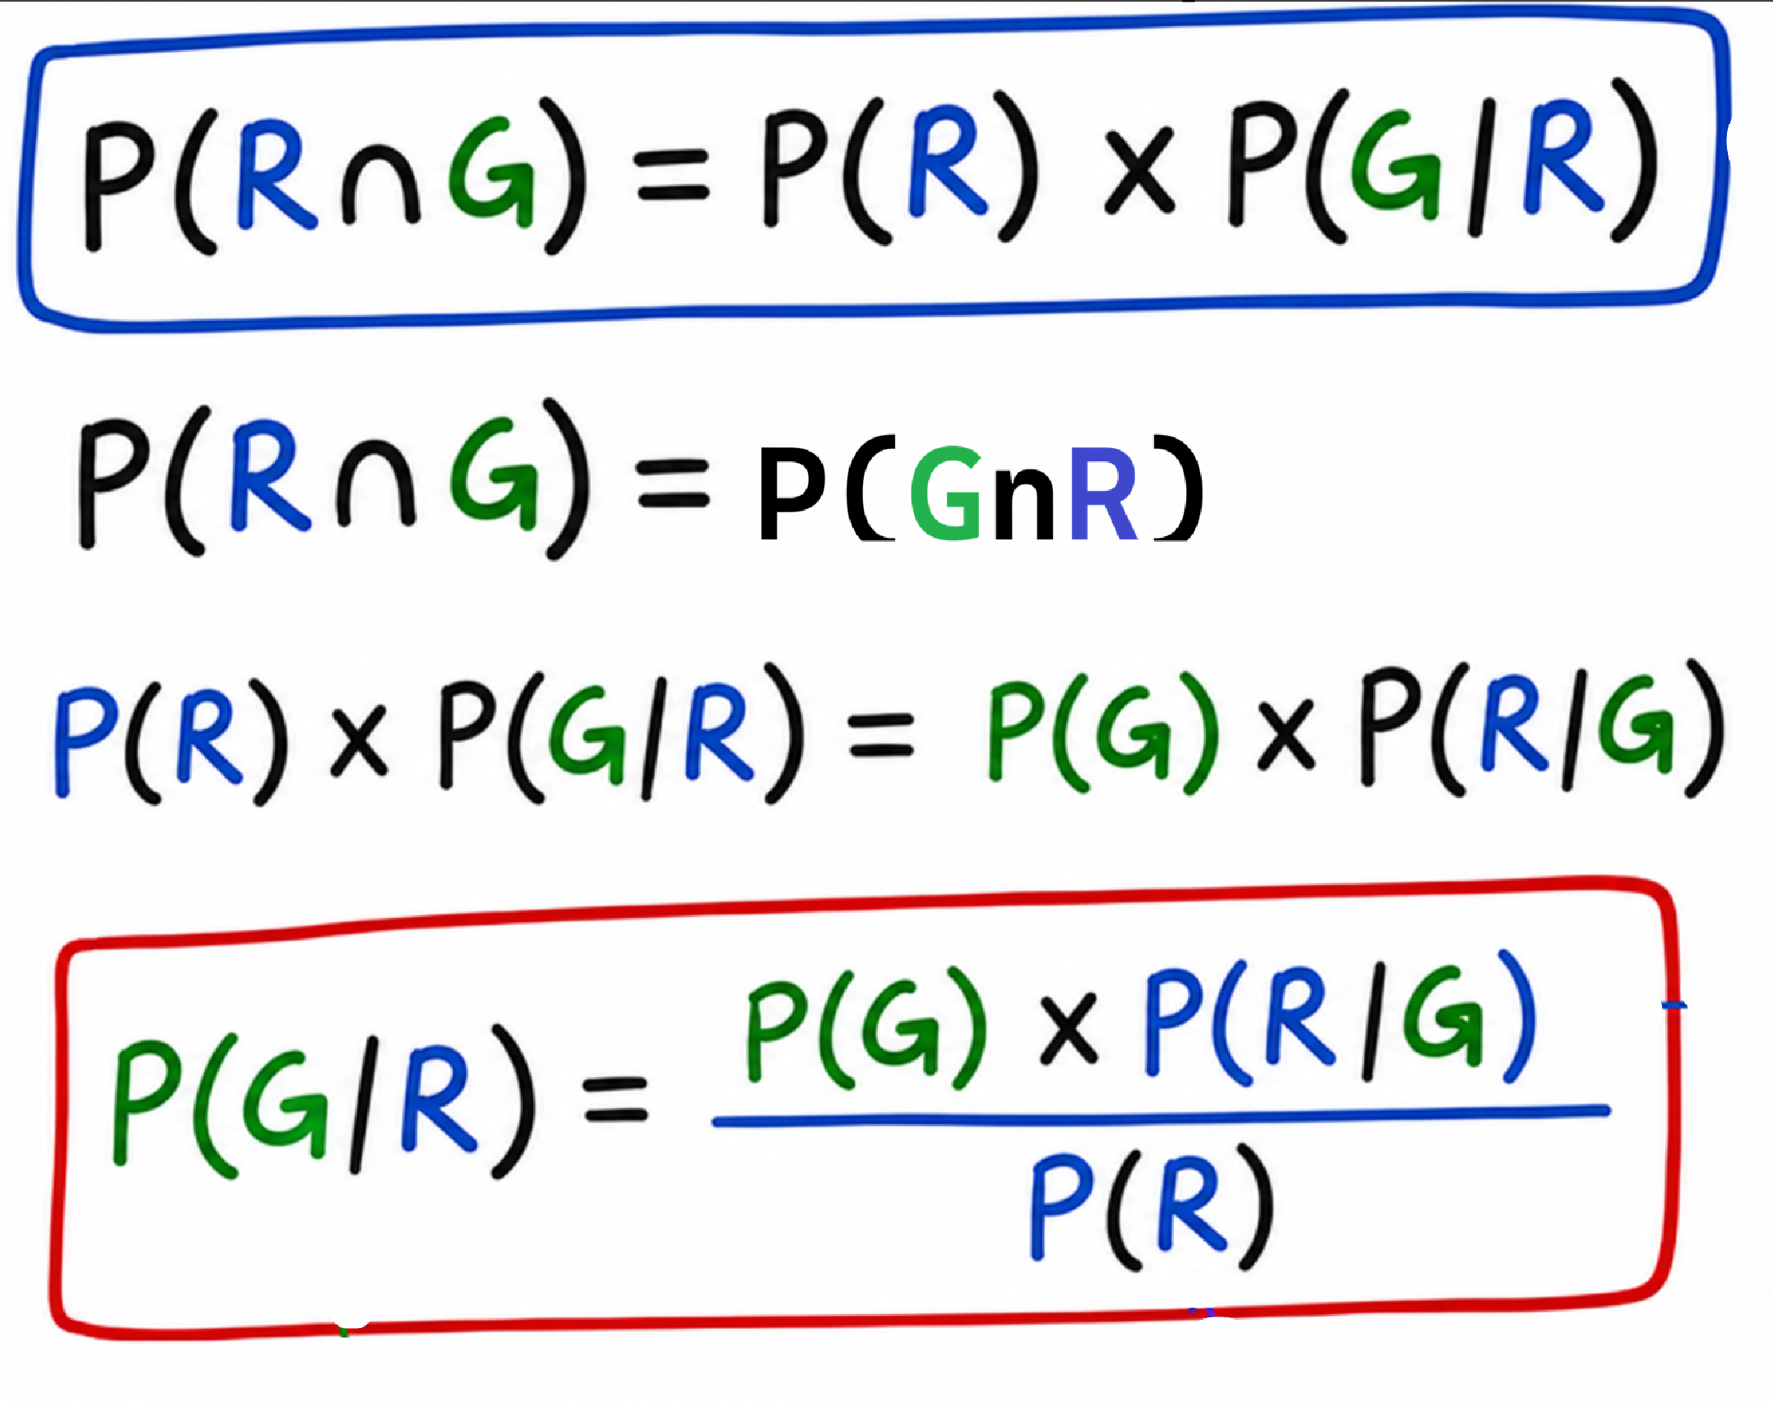
Naïve Bayes
Derivation :

Slide 6


TRANSITIONING TO
MACHINE LEARNING
Event B →
y
Event A →
X
The Target Class we want to predict.
The set of Input Features (Evidence).
P(y) × P(X|y)
P(y|X) =
P(X)

Slide 7
THE
NAIVE
INDEPENDENCE ASSUMPTION
WHY "NAIVE"?
The Assumption:
It assumes that every feature is
Independent
of every other feature, given the class
label.
The Reality: In real-world data, features are often correlated (e.g., "Height" and "Weight").
The Choice: We intentionally ignore these dependencies to simplify the math.
.

Slide 8
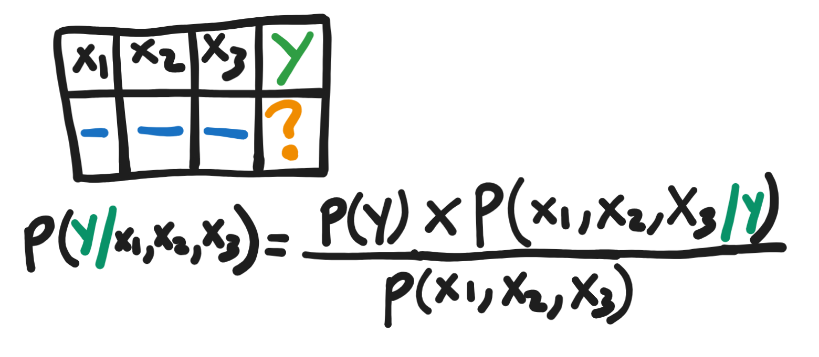
How We Actually Make Predictions on the Dataset
Independent
.

Slide 9
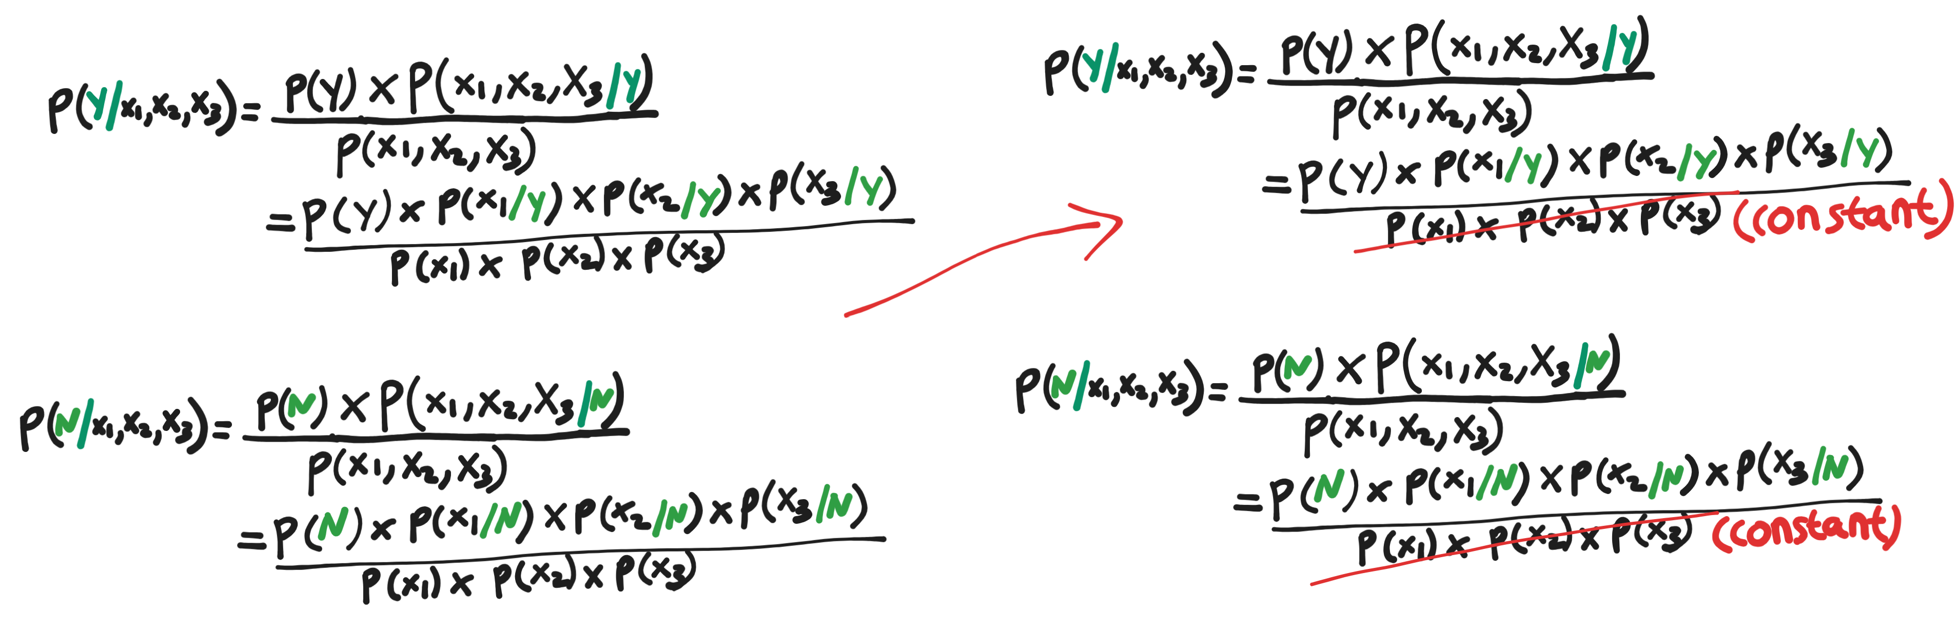
Continue …
Independent
.

Slide 10
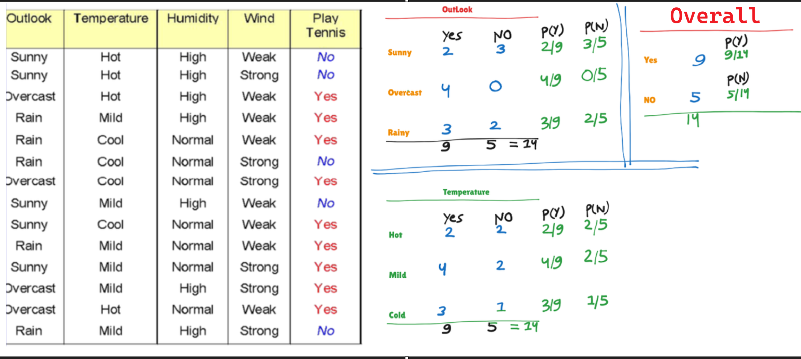
Continue …
.

Slide 11
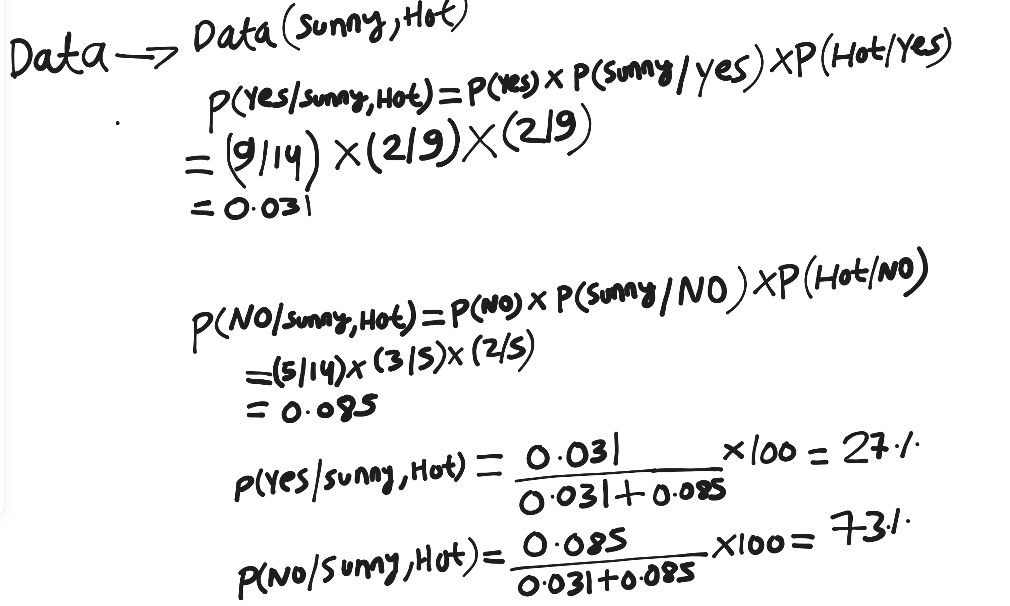
Continue …
.

Slide 12

SUMMARY &
CONCLUSION
Scalability
: Handles high-dimensional data with ease, making it
ideal for text classification.
Performance
: Extremely fast training and prediction times for
real-time applications.
Robustness
: Performs remarkably well even with limited data and
"naive" assumptions.
Baseline
: Serves as the perfect baseline model for complex
classification tasks.

